Slide 1
The Mom Test
David Simner

Slide 2
Goal
Let's make some software
Make some money

Slide 3
You’re searching for a meaningful problem that a customer segment has
Must-solve-right-now vs nice-to-have
If they haven't looked for ways of solving it already, they're not going to look for (or buy) yours.
Notes:
Page 51,57 (summary of 50-58) + 23

Slide 4
What we’re looking for
Customer segment that is
Profitable
Easy to reach
Rewarding for us to build a business around
Notes:
Page 107 (summary of 101-110)

Slide 5
Risks
Product risk
Market risk
Notes:
Page 61 (summary of 58-62)

Slide 6
Talk about their life instead of your idea
Stop seeking approval
Cut off pitches
Deflect compliments
Notes:
Page 17 + 42-44 + 44-45 + 28-32

Slide 7
The customers own the problem; you own the solution.
Notes:
Page 26

Slide 8
Talk less and listen more
No interrupting
Dig beneath ideas
Notes:
Page 17 + 45 + 38-42

Slide 9
Ask about specifics in their past, instead of generics or opinions about the future
Anchor fluff
Notes:
Page 17 + 32-38

Slide 10
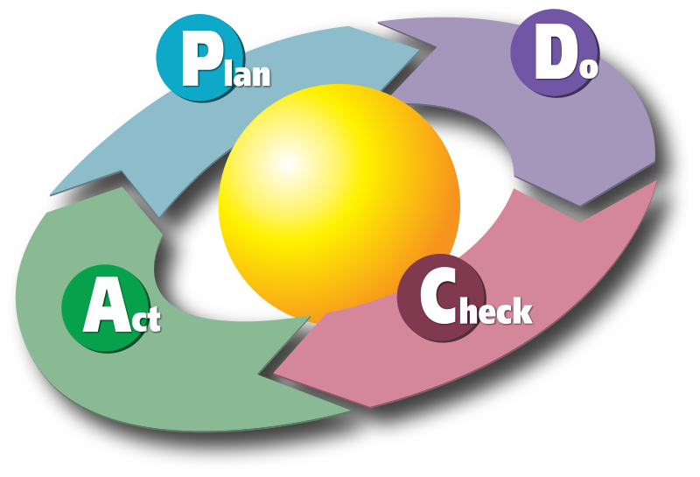
Notes:
Page 121-123

Slide 11
Prepare your list of 3
Notes:
Page 63 + 112-114

Slide 12
Pushing for commitment and advancement
Time
Reputation
Financial
Notes:
Page 76 (summary of 73-82)

Slide 13
</talk> any questions?

